Slide 1
Fast Control of Multimode Cavities with Conditional Displacements
Eesh Gupta, S. Chakram, …

Slide 2
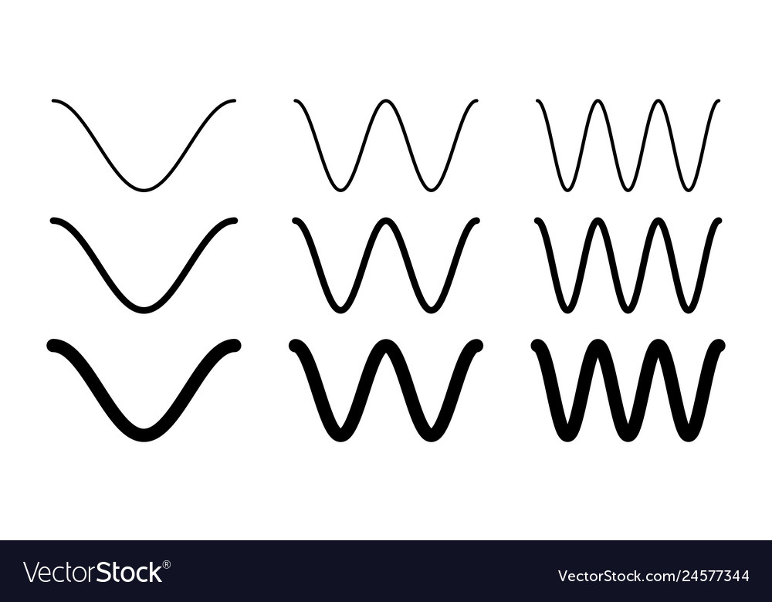
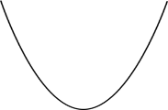
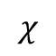
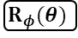
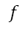
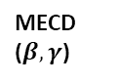
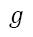
Outline
Challenges in Cavity Control
$$χ$$
$$f$$
$$e$$
$$g$$
Multimode Conditional Displacements
Mode 1
MECD ($β,γ$)
Mode 2
Qubit
$$R_{φ}(θ)$$
Alternative Schemes:
Circle Grape and Sideband Driving

Slide 3
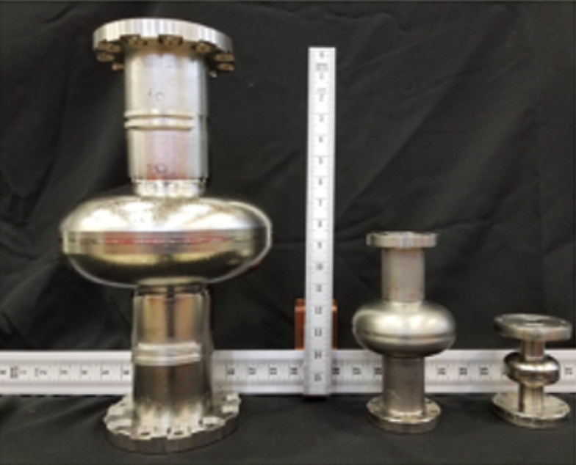
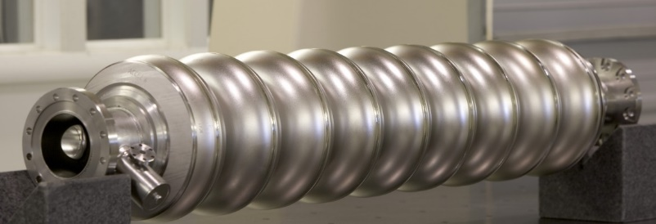



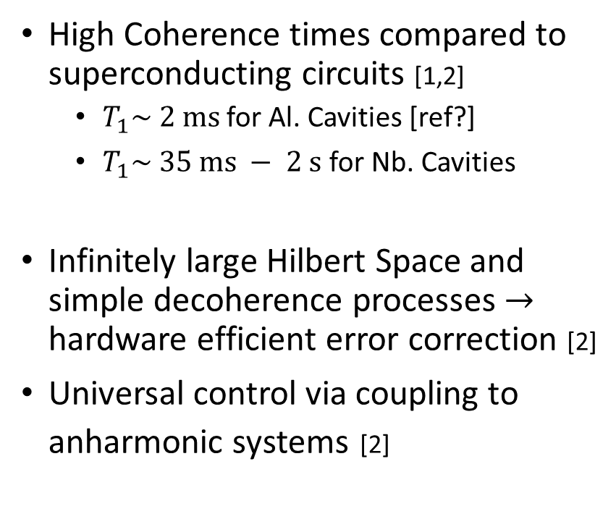

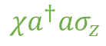
3D Cavity QED
High Coherence times compared to superconducting circuits [1,2]
$T_{1}\sim 2 ms$ for Al. Cavities [ref?]
$T_{1}\sim 35 ms − 2 s$ for Nb. Cavities
Infinitely large Hilbert Space and simple decoherence processes $→$ hardware efficient error correction [2]
Universal control via coupling to anharmonic systems [2]
[1] Romanenko, A., et al. Physical Review Applied 13.3 (2020): 034032.
$$f$$
$$e$$
$$g$$
$$χa^{†}aσ_{z}$$
Transmon
Cavity Mode
Goal: Enact high-speed operations on cavity modes while minimizing ancilla errors
[2] Ma, Wen-Long, et al. Science Bulletin 66.17 (2021): 1789-1805.

Slide 4

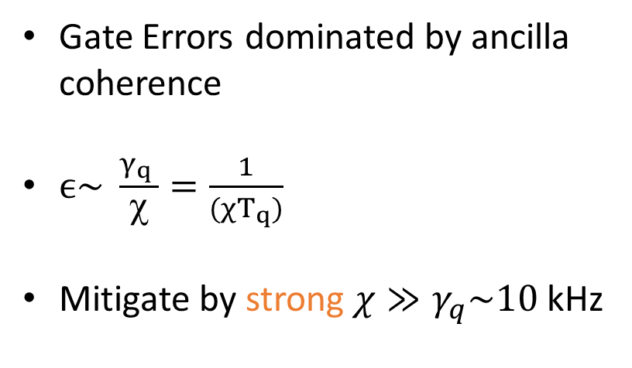
Challenges in Cavity Control I
Coupling to lossy ancilla source of error for high-Q cavities!
Transmon Relaxation
gate pulse(s)
Cavity Mode
Gate Errors dominated by ancilla coherence
$ϵ\sim \frac{γ_{q} }{χ}=\frac{1}{(χT_{q})}$
Mitigate by strong $χ≫γ_{q}\sim 10$kHz
…
Qubit
bath
Eickbusch, A., Sivak, V., Ding, A.Z. et al. Nat. Phys. 18, 1464–1469 (2022)

Slide 5
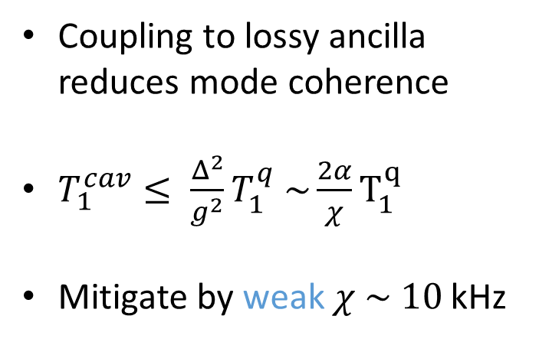
Challenges in Cavity Control II
Coupling to lossy ancilla source of error for high-Q cavities!
Inverse Purcell Effect
Cavity Mode
Coupling to lossy ancilla reduces mode coherence
$T_{1}^{cav}≤ \frac{Δ^{2}}{g^{2}}T_{1}^{q} \sim \frac{2α}{χ}T_{1}^{q}$
Mitigate by weak $χ \sim 10$ kHz
…
Qubit
bath
Boissonneault, M., et al. Physical Review A, 79(1), 013819.(2009)

Slide 6
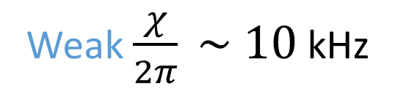
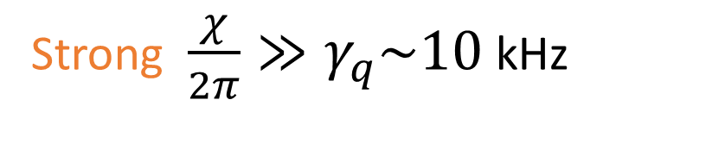
Challenges in Cavity Control III
Coupling to lossy ancilla source of error for high-Q cavities!
Transmon Relaxation
Inverse Purcell Effect
Strong $\frac{χ}{2π}≫γ_{q}\sim 10$kHz
Weak $\frac{χ}{2π} \sim 10$ kHz

Slide 7
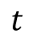
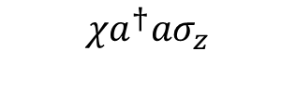
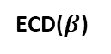
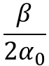
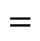
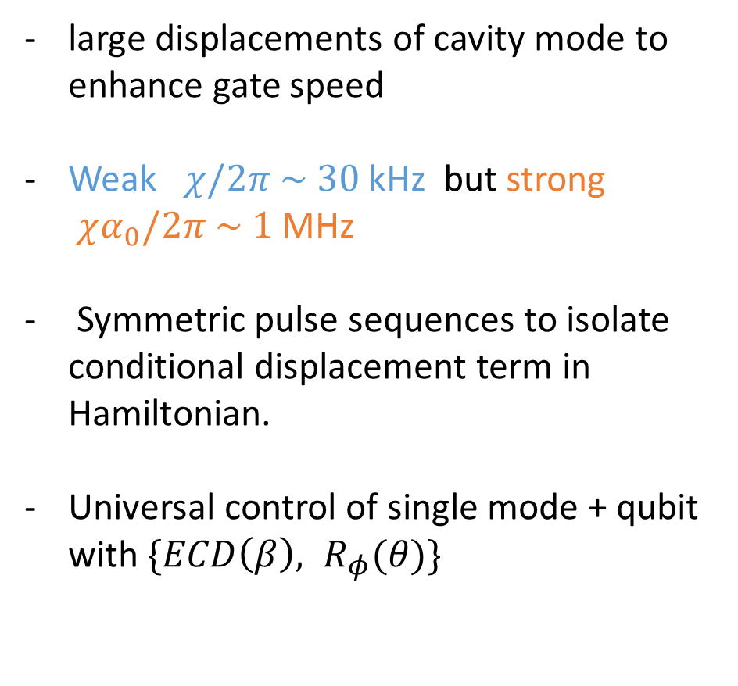
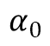
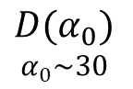

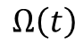
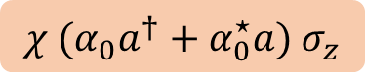

Conditional Displacement Gates
large displacements of cavity mode to enhance gate speed
Weak $χ/2π \sim 30$ kHz but strong $χα_{0}/2π \sim 1$ MHz
Symmetric pulse sequences to isolate conditional displacement term in Hamiltonian.
Universal control of single mode + qubit with $\{ECD\left(β\right), R_{φ}(θ)\}$
$$χa^{†}aσ_{z}$$
$$χ{ (α_{0}a}^{†}+α_{0}^{⋆}a) σ_{z}$$
$$D(α_{0})$$
$$α_{0}\sim 30$$
$$α_{0}$$
$$ε\left(t\right)$$
Mode
ECD($β$)
$$t$$
$$=$$
$$\frac{β}{2α_{0}}$$
Qubit
$$Ω\left(t\right)$$
$$π$$
Hacohen-Gourgy, S., Martin, L., Flurin, E. et al. Nature 538, 491–494 (2016).
Eickbusch, A., Sivak, V., Ding, A.Z. et al. Nat. Phys. 18, 1464–1469 (2022)

Slide 8
Outline
Challenges in Cavity Control
$$χ$$
$$f$$
$$e$$
$$g$$
Multimode Conditional Displacements
Mode 1
MECD ($β,γ$)
Mode 2
Qubit
$$R_{φ}(θ)$$
Alternative Schemes

Slide 9
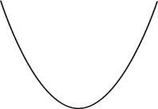
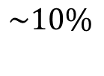
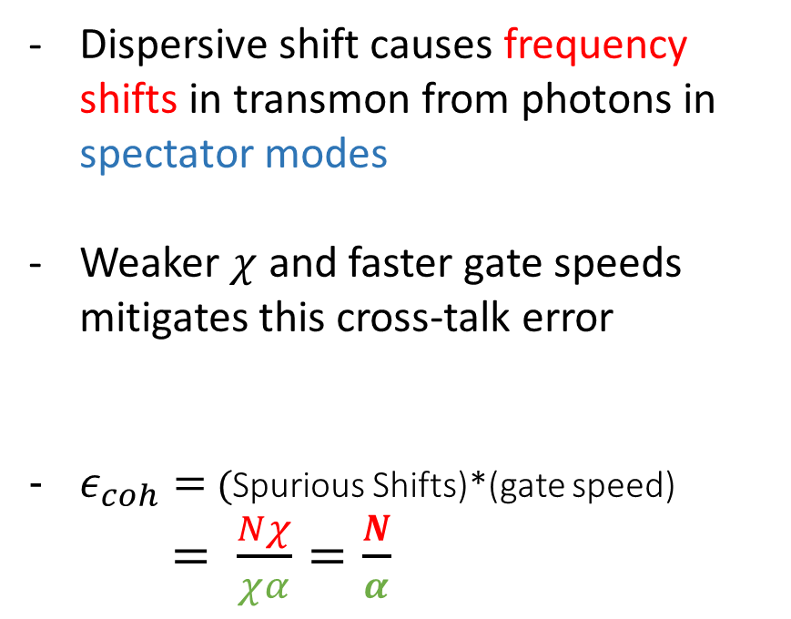
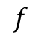
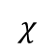
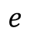
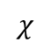
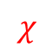
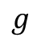
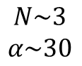
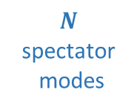
Coherent Errors
Dispersive shift causes frequency shifts in transmon from photons in spectator modes
Weaker $χ$ and faster gate speeds mitigates this cross-talk error
$ε_{coh}=$ (Spurious Shifts)*(gate speed)
$= \frac{Nχ}{χα}=\frac{N}{α}$
$N$
spectator
modes
$$χ$$
$$f$$
$$e$$
$$g$$
$$χ$$
$$χ$$
Target Modes
$$\sim 10\%$$
$$N\sim 3$$
$$α\sim 30$$

Slide 10
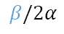
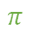
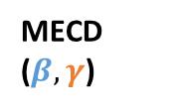
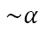
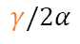
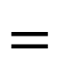


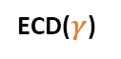
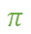
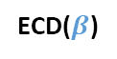
Multimode ECD
Sequentially acting ECD Gates on each mode
Driving modes one at a time to avoid heating effects and amplifying cross kerr interaction [1, 2]
Instead of enhanced cross kerr interaction, rely on JC-like interaction between ‘tunable qubit’ and modes
Mode 1
MECD ($β,γ$)
Mode 1
ECD($γ$)
Mode 2
$$=$$
Mode 2
ECD($β$)
Qubit
Qubit
$$\sim α$$
$$π$$
$$ε_{1}\left(t\right)$$
$$t$$
$$β/2α$$
$$\sim α$$
$$π$$
$$ε_{2}\left(t\right)$$
$$t$$
[1] Eickbusch, Alec , et al. W34. 00005. APS March Meeting (2022).
[2] Diringer, Asaf A., et al. arXiv preprint arXiv:2301.09831 (2023).
$$γ/2α$$

Slide 11
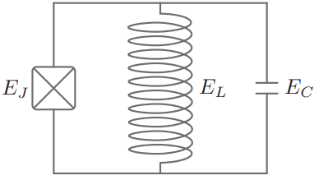
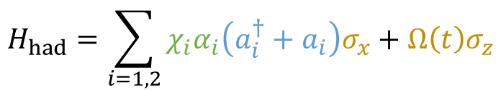
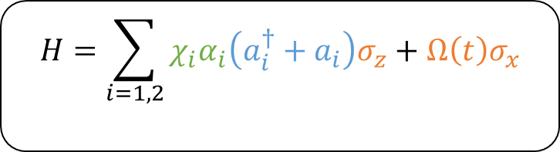
Multimode ECD
Sequentially acting ECD Gates on each mode
Driving modes one at a time to avoid heating effects and amplifying cross kerr interaction. [1][2]
Instead of enhanced cross kerr interaction, rely on JC-like interaction between ‘tunable qubit’ and modes
$$H=\sum_{i=1,2}{χ_{i}α_{i}\left(a_{i}^{†}+a_{i}\right)σ_{z}+Ω\left(t\right)σ_{x}}$$
$$H_{had}=\sum_{i=1,2}{χ_{i}α_{i}\left(a_{i}^{†}+a_{i}\right)σ_{x}+Ω\left(t\right)σ_{z}}$$
Conditional Displacement
Qubit
Drive
Jaynes Cummings
Tunable
Qubit
[1] Eickbusch, Alec , et al. W34. 00005. APS March Meeting (2022).
[2] Diringer, Asaf A., et al. arXiv preprint arXiv:2301.09831 (2023).

Slide 12
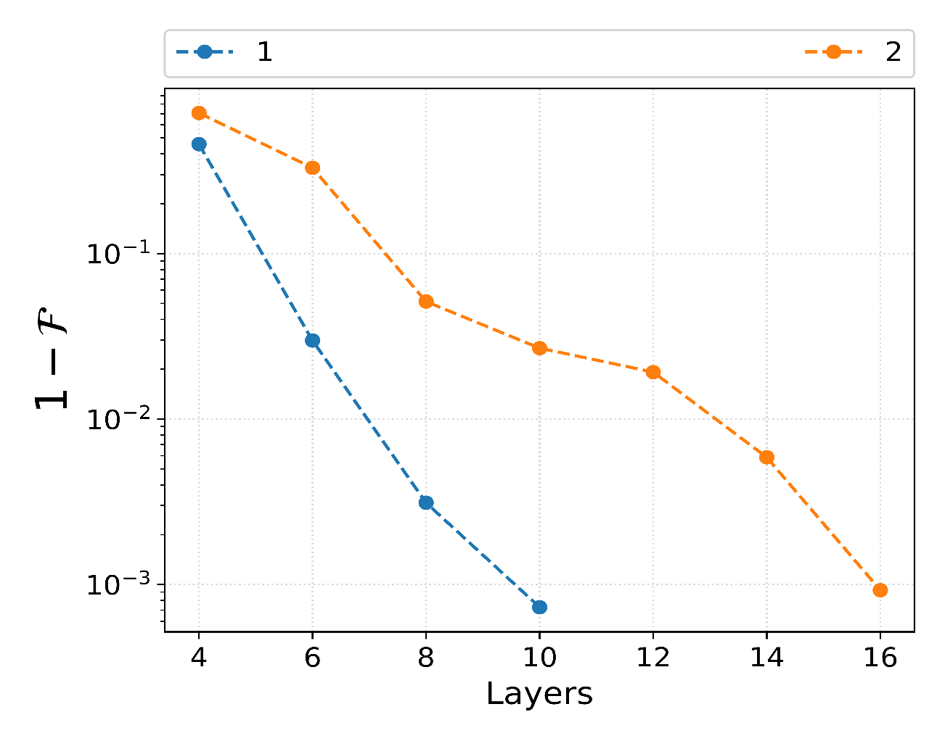
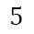







Multimode ECD: State Transfer I
Task: $g⊗\left|n0\right\rangle →g⊗\left|0n\right\rangle$
Optimized Pulse Sequences with fidelity < 1e-3
Mode 1
MECD ($β,γ$)
1 layer/depth =
Mode 2
Qubit
$$5$$
$$10$$
$$15$$
$$t (μs)$$
$$R_{φ}(θ)$$
$$χα \sim 1μs$$

Slide 13






Multimode ECD: State Transfer II
$$g⊗\left|10\right\rangle →g⊗\left|01\right\rangle$$
$$g⊗\left|20\right\rangle →g⊗\left|02\right\rangle$$

Slide 14





Multimode ECD: Error Budget
$T_{1,q}=85 μs$
$T_{2, q}=98 μs$
$T_{1, c }=2 ms$
$T_{φ, c }=150 ms$ *
$$2κ_{φ}D\left[a^{†}a\right]ρ$$
$$2κ_{φ}{\left|α\right|}^{2}\left(D\left[a\right]\tilde{ρ}+D\left[a^{†}\right]\tilde{ρ}\right)+ ...$$
Displaced Frame
$$\sim {\left(83 μs\right)}^{−1}$$
*Eickbusch, A., Sivak, V., Ding, A.Z. et al. Nat. Phys. 18, 1464–1469 (2022)

Slide 15
Outline
Challenges in Cavity Control
$$χ$$
$$f$$
$$e$$
$$g$$
Multimode Conditional Displacements
Mode 1
MECD ($β,γ$)
Mode 2
Qubit
$$R_{φ}(θ)$$
Alternative Schemes

Slide 16




Circle GRAPE
Combines displacement enhanced $χα$ technique with GRAPE [1,2]
Detuning causes squeezed state to rotate in phase space
Currently, only the qubit drive is optimized
Conditional Displacement
$$H=\sum_{i=1, 2}{Δ_{i}a_{i}^{†}a_{i} +χ_{i}{\left(a_{i}^{†}+α_{i}^{∗}\right)\left(a_{i}+α_{i}\right)σ}_{z}}$$
$$+{ Ω}_{x}\left(t\right)σ_{x}+Ω_{y}\left(t\right)σ_{y}$$
Qubit Drive
$$Im(α)$$
$$Re(α)$$
[1] N. Khaneja et al. Journal of Magnetic Resonance 172, 29 (2005)
[2] Eickbusch, A., Elder, S., et al. In APS March Meeting Abstracts (Vol. 2021, pp. V31-005).

Slide 17




Example: $\left|g10\right\rangle →|g01⟩$
Simulation Parameters
$Δ_{c}=2π×10$Mhz
$|Ω|=2π ×10$Mhz
$χ_{1}, χ_{2}=2π×33$kHz
$α_{1}, α_{2}=30$

Slide 18
Conclusion
Challenges in Cavity Control
$$χ$$
$$f$$
$$e$$
$$g$$
Multimode Conditional Displacements
Mode 1
MECD ($β,γ$)
Mode 2
Qubit
$$R_{φ}(θ)$$
Alternative Schemes

Slide 19







Circle GRAPE
$$|g⟩$$
$$H=χ\left(αa^{†}+α^{∗}a\right)σ_{z}$$
$$|e⟩$$
$$Im(α)$$
Combines displacement enhanced $χα$ technique with GRAPE algorithm
Cavity drives detuned
$$Re(α)$$
$$H=Δ_{c}a^{†}a+ χ\left(αa^{†}+α^{∗}a\right)σ_{z}$$
$$Im(α)$$
Rotate in circle because of detuning; is this a spiral?
$$Re(α)$$
Elder S., et al. Bulletin of the American Physical Society 66 (2021)

